Slide 1
ENEL 419
Mathematical Expectations of Discrete Random Variables
Reading Exercise: Montgomery and Runger Sections 3.3 - 3.8 (Yates and Goodman Sections 3.5 -3.8)

Slide 2
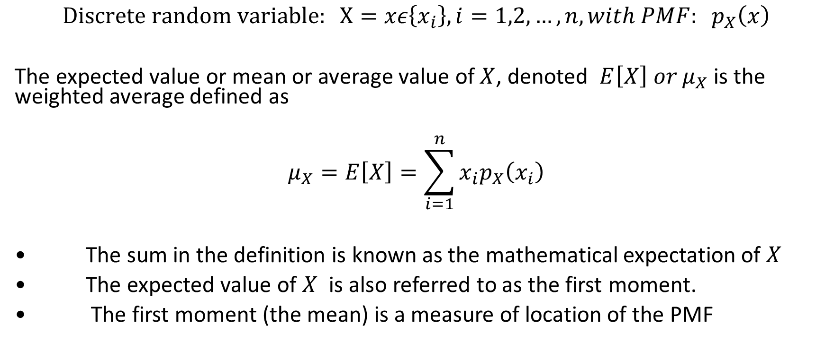
Mathematical Expectations (Expected value or Mean value)
$$Discrete random variable: X=xε\left\{x_{i}\right\}, i=1,2,…,n, with PMF: p_{X}\left(x\right)$$
The expected value or mean or average value of $X$, denoted $E\left[X\right] or μ_{X}$ is the weighted average defined as
$$μ_{X}=E\left[X\right]=\sum_{i=1}^{n}{x_{i}p_{X}\left(x_{i}\right)}$$
• The sum in the definition is known as the mathematical expectation of $X$
• The expected value of $X$ is also referred to as the first moment.
• The first moment (the mean) is a measure of location of the PMF

Slide 3
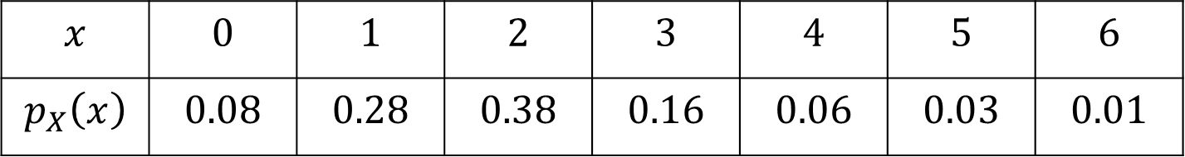
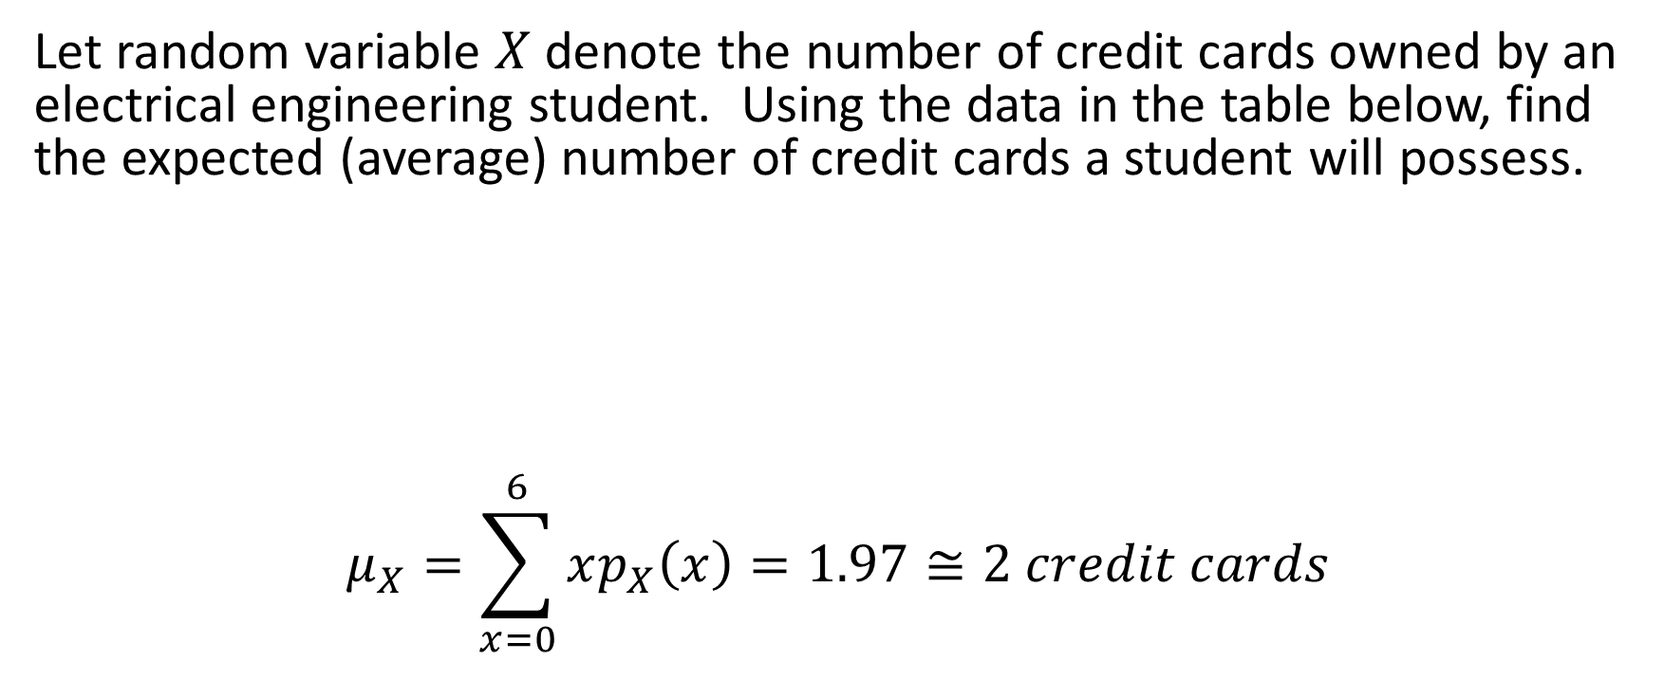
Mathematical Expectations Example 1
Let random variable $X$ denote the number of credit cards owned by an electrical engineering student. Using the data in the table below, find the expected (average) number of credit cards a student will possess.
$$μ_{X}=\sum_{x=0}^{6}{xp_{X}\left(x\right)=1.97≅2 credit cards}$$
$$x$$ | $$0$$ | $$1$$ | $$2$$ | $$3$$ | $$4$$ | $$5$$ | $$6$$
$$p_{X}\left(x\right)$$ | $$0.08$$ | $$0.28$$ | $$0.38$$ | $$0.16$$ | $$0.06$$ | $$0.03$$ | $$0.01$$

Slide 4
Example 2
A quality control engineer is inspecting a batch of 7 electronic components consisting of 4 good components and 3 defective components. The engineer takes a sample of 3 components. (a) Find the PMF of the good components and (b) Find the expected value of the number of good components in this sample.

Slide 5
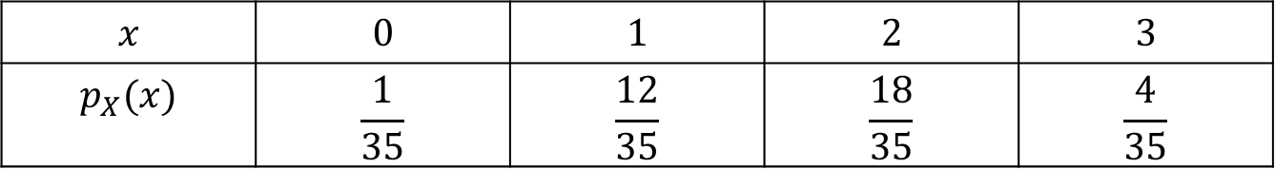

Example 2 continued
Let random variable $X=x$ denote number of good components selected from $7$ components. The number of defective components selected is $3−x$.
$$x$$ | $$0$$ | $$1$$ | $$2$$ | $$3$$
$$p_{X}(x)$$ | $$\frac{1}{35}$$ | $$\frac{12}{35}$$ | $$\frac{18}{35}$$ | $$\frac{4}{35}$$

Slide 6
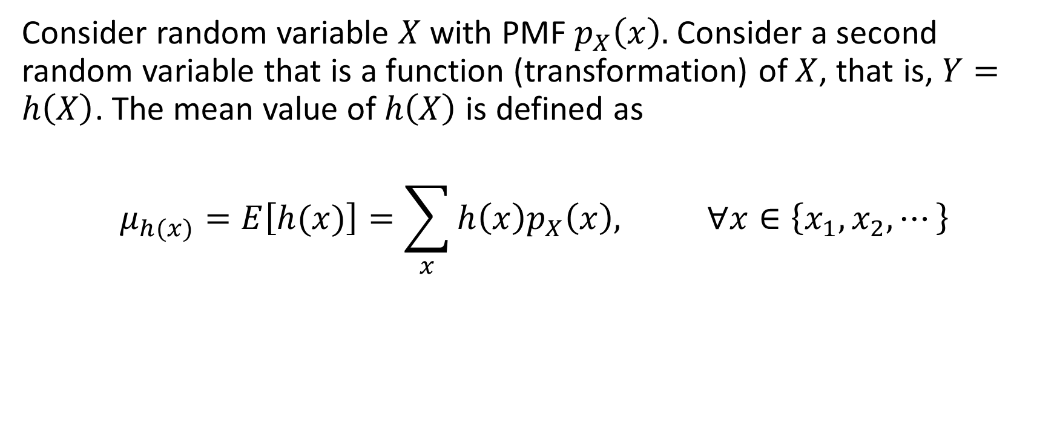
Expected Value of a Function of a Discrete Random Variable
Consider random variable $X$ with PMF $p_{X}\left(x\right).$ Consider a second random variable that is a function (transformation) of $X$, that is, $Y=h\left(X\right)$. The mean value of $h\left(X\right)$ is defined as
$$μ_{h(x)}=E\left[h(x)\right]=\sum_{x}{h\left(x\right)p_{X}\left(x\right), ∀x∈\left\{x_{1}, x_{2}, ⋯\right\}}$$

Slide 7
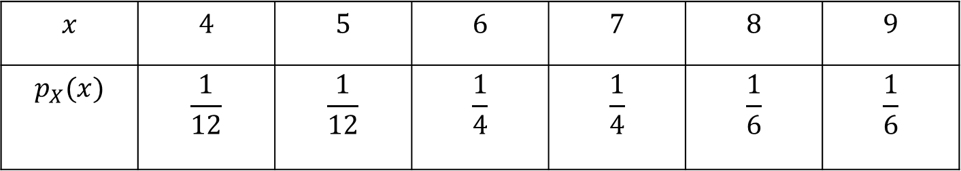
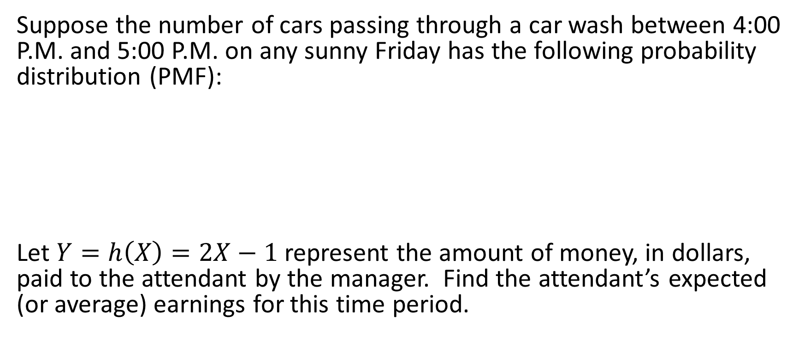
Expected Value of a Function of a Discrete Random Variable - Example 3
Suppose the number of cars passing through a car wash between 4:00 P.M. and 5:00 P.M. on any sunny Friday has the following probability distribution (PMF):
Let $Y=h\left(X\right)=2X−1$ represent the amount of money, in dollars, paid to the attendant by the manager. Find the attendant’s expected (or average) earnings for this time period.
$$x$$ | $$4$$ | $$5$$ | $$6$$ | $$7$$ | $$8$$ | $$9$$
$$p_{X}(x)$$ | $$\frac{1}{12}$$ | $$\frac{1}{12}$$ | $$\frac{1}{4}$$ | $$\frac{1}{4}$$ | $$\frac{1}{6}$$ | $$\frac{1}{6}$$

Slide 8

Example 3 continued
$$μ_{Y}=\sum_{x=4}^{9}{\left(2x−1\right)p_{X}\left(x\right)}=\frac{1}{12}\left(7+9+33+39+30+34\right)≅12.67$$
Attendant’s average earning is $12.67

Slide 9
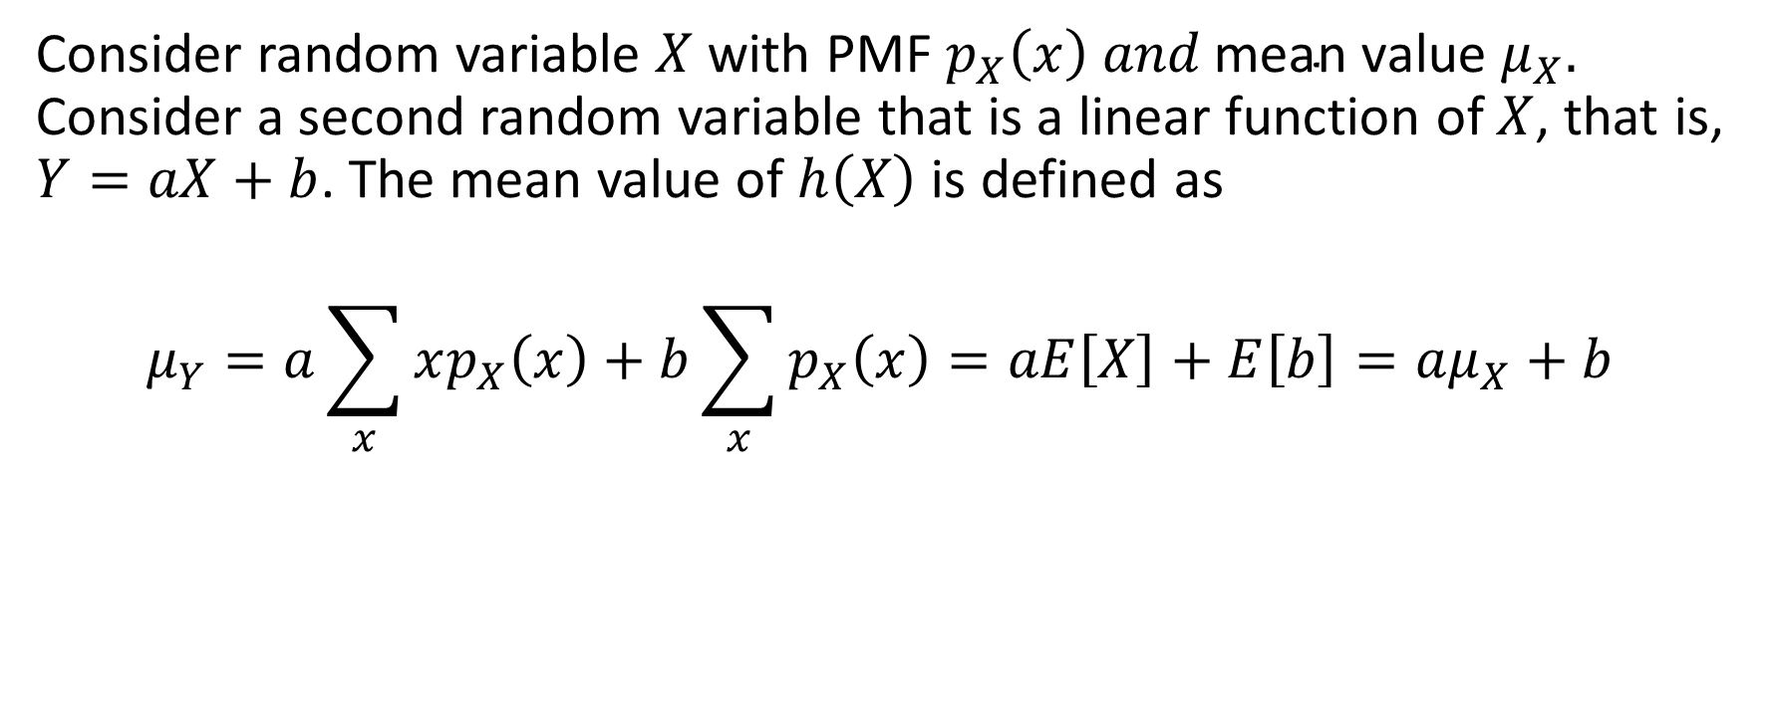
Linearity Property of the Mathematical Expectation
Consider random variable $X$ with PMF $p_{X}\left(x\right) and \text{mean} \text{value} μ_{X}.$ Consider a second random variable that is a linear function of $X$, that is, $Y=aX+b$. The mean value of $h\left(X\right)$ is defined as
$$μ_{Y}=a\sum_{x}{xp_{X}\left(x\right)}+b\sum_{x}{p_{X}\left(x\right)}=aE\left[X\right]+E\left[b\right]=aμ_{X}+b$$

Slide 10
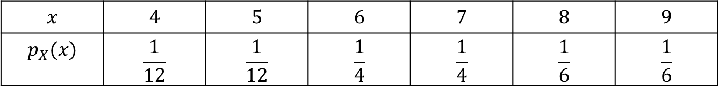
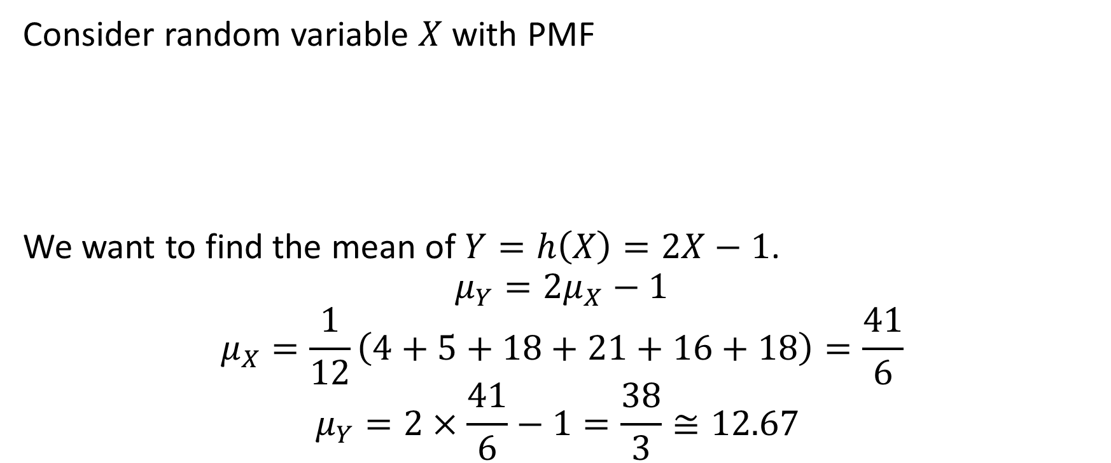
Linearity example
Consider random variable $X$ with PMF
We want to find the mean of $Y=h\left(X\right)=2X−1$.
$$μ_{Y}=2μ_{X}−1$$
$$μ_{X}=\frac{1}{12}\left(4+5+18+21+16+18\right)=\frac{41}{6}$$
$$μ_{Y}=2×\frac{41}{6}−1=\frac{38}{3}≅12.67$$

Slide 11

Exercise
Calculate the mean of $Y=2X+3$where $X$ is a random variable whose PMF is given in the table below.
$$μ_{Y}=E\left[Y\right]=\sum_{x=4}^{9}{\left(2x+3\right)p_{X}(x)}$$

Slide 12
Variance and Standard Deviation of Discrete Random Variables
Variance:
Standard deviation:

Slide 13
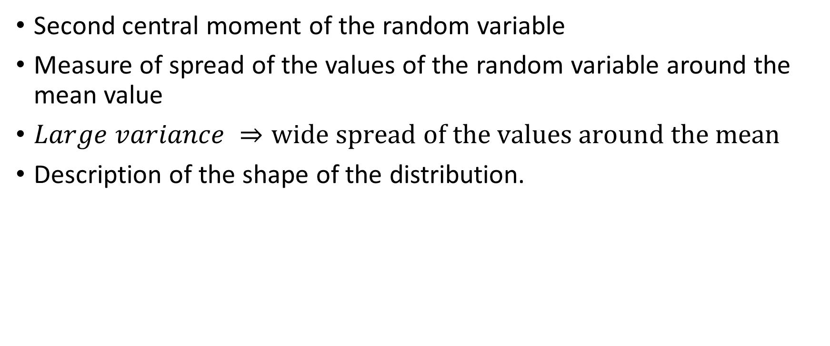
Interpretation of Variance
Second central moment of the random variable
Measure of spread of the values of the random variable around the mean value
$Large variance ⇒wide spread of the values around the mean$
Description of the shape of the distribution.

Slide 14
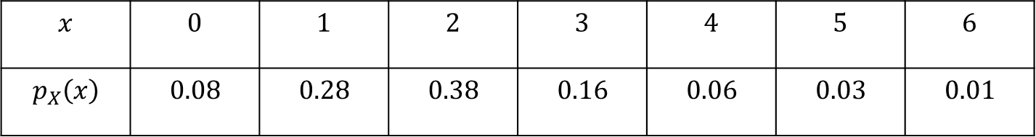

Exercise
Consider random variable $X$ with PMF:
Calculate the variance and standard deviation of X

Slide 15
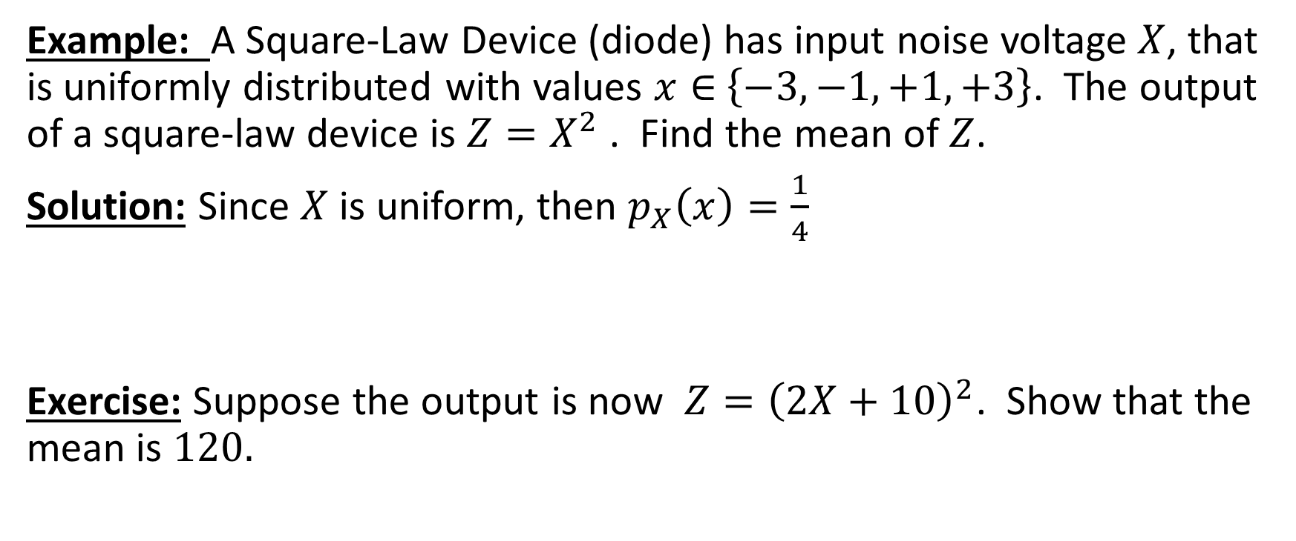
Example
Example: A Square-Law Device (diode) has input noise voltage $X$, that is uniformly distributed with values $x∈$ $\left\{−3, −1, +1,+3\right\}$. The output of a square-law device is $Z=X^{2}$ . Find the mean of $Z$.
Solution: Since $X$ is uniform, then $p_{X}\left(x\right)=\frac{1}{4}$
Exercise: Suppose the output is now $Z={\left(2X+10\right)}^{2}$. Show that the mean is $120.$

Slide 16
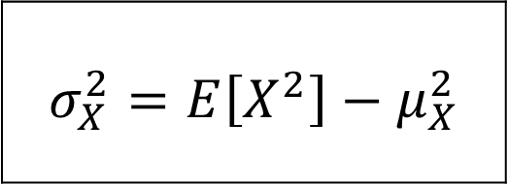
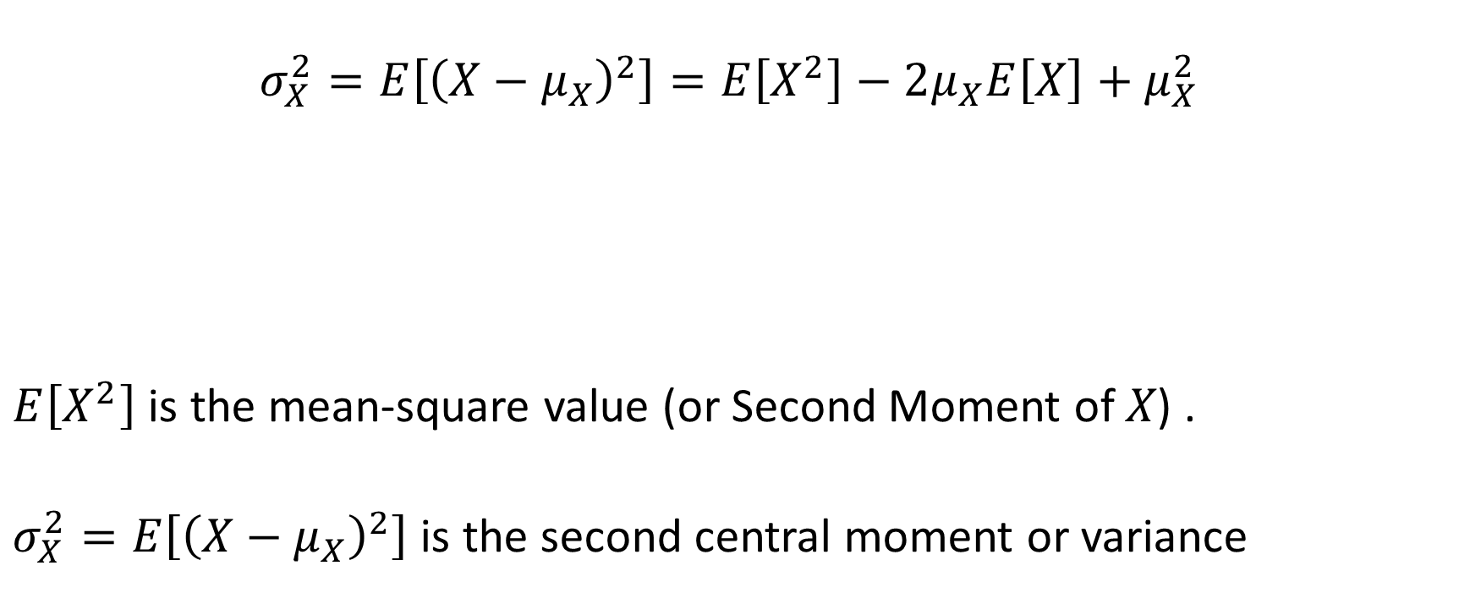
Short-cut Formula for Variance
$$σ_{X}^{2}=E\left[{\left(X−μ_{X}\right)}^{2}\right]=E\left[X^{2}\right]−2μ_{X}E\left[X\right]+μ_{X}^{2}$$
$E\left[X^{2}\right]$ is the mean-square value (or Second Moment of 𝑋) .
$σ_{X}^{2}=E\left[{\left(X−μ_{X}\right)}^{2}\right]$ is the second central moment or variance
$$σ_{X}^{2}=E\left[X^{2}\right]−μ_{X}^{2}$$

Slide 17



Properties of Variance
$$σ_{Y}^{2}=E\left[Y^{2}\right]−μ_{Y}^{2}$$
$Y=b=const.⇒μ_{Y}=b; E\left[Y^{2}\right]= b^{2}⇒$
$Y=aX⇒μ_{Y}=aμ_{X};$
$$E\left[Y^{2}\right]=\sum_{x}{a^{2}x^{2}p_{X}\left(x\right)=a^{2}E\left[X^{2}\right]}$$
$$σ_{Y}^{2}=a^{2}E\left[X^{2}\right]−a^{2}μ_{X}^{2}=a^{2}\left(E\left[X^{2}\right]−μ_{X}^{2}\right)$$
$$σ_{Y}^{2}=0$$
$$σ_{Y}^{2}=a^{2}σ_{X}^{2}$$

Slide 18
Useful Series in Probability Theory

Slide 19

Mean of Special Discrete Random Variables
Bernoulli Random Variable:
$$p_{X}\left(x\right)=p^{x}{\left(1−p\right)}^{1−x}, x=0, 1$$
$$μ_{X}=E\left[X\right]=0×p_{X}\left(0\right)+1×p_{X}\left(1\right)=p$$
Binomial Random Variable:
$$X=\sum_{i=1}^{n}{X_{i}}$$
$$μ_{X}=E\left[X\right]=\sum_{i=1}^{n}{E\left[X_{i}\right]=np}$$

Slide 20
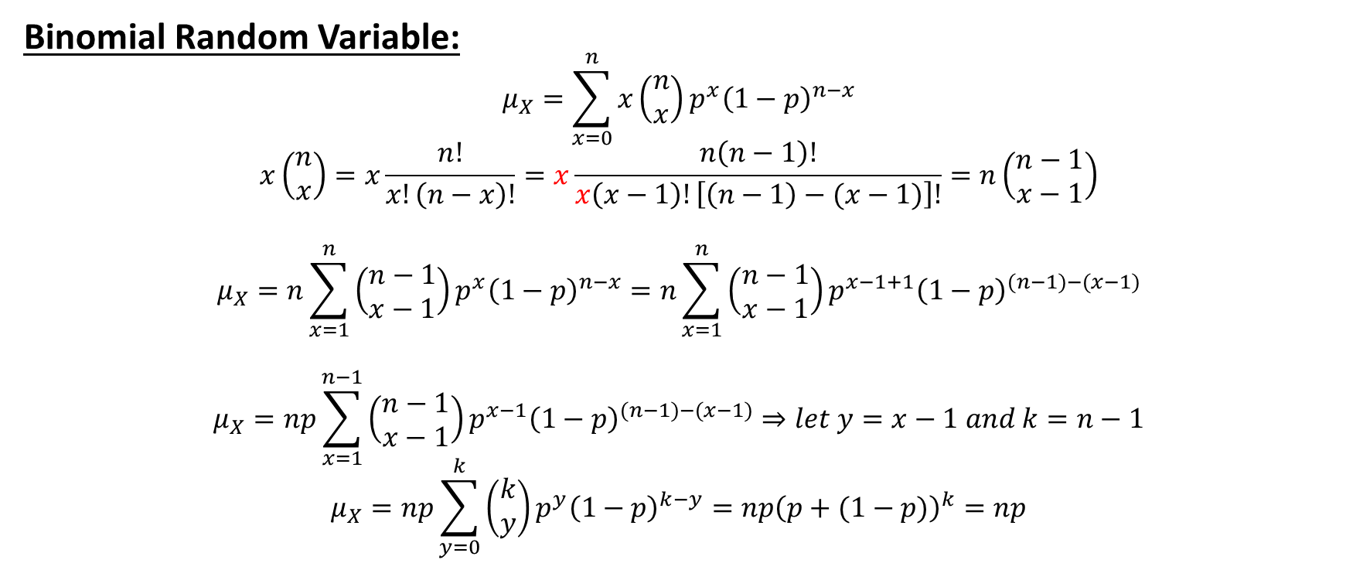
Mean of Special Discrete Random Variables
Binomial Random Variable:
$$μ_{X}=\sum_{x=0}^{n}{x\left(\begin{aligned}n \\ x\end{aligned}\right)p^{x}{\left(1−p\right)}^{n−x}}$$
$$x\left(\begin{aligned}n \\ x\end{aligned}\right)=x\frac{n!}{x!\left(n−x\right)!}=x\frac{n\left(n−1\right)!}{x\left(x−1\right)!\left[\left(n−1\right)−(x−1)\right]!}=n\left(\begin{aligned}n−1 \\ x−1\end{aligned}\right)$$
$$μ_{X}=n\sum_{x=1}^{n}{\left(\begin{aligned}n−1 \\ x−1\end{aligned}\right)p^{x}{\left(1−p\right)}^{n−x}}=n\sum_{x=1}^{n}{\left(\begin{aligned}n−1 \\ x−1\end{aligned}\right)p^{x−1+1}{\left(1−p\right)}^{(n−1)−(x−1)}}$$
$$μ_{X}=np\sum_{x=1}^{n−1}{\left(\begin{aligned}n−1 \\ x−1\end{aligned}\right)p^{x−1}{\left(1−p\right)}^{(n−1)−(x−1)}}⇒let y=x−1 and k=n−1$$
$$μ_{X}=np\sum_{y=0}^{k}{\left(\begin{aligned}k \\ y\end{aligned}\right)p^{y}{\left(1−p\right)}^{k−y}=np{\left(p+(1−p)\right)}^{k}=np}$$

Slide 21
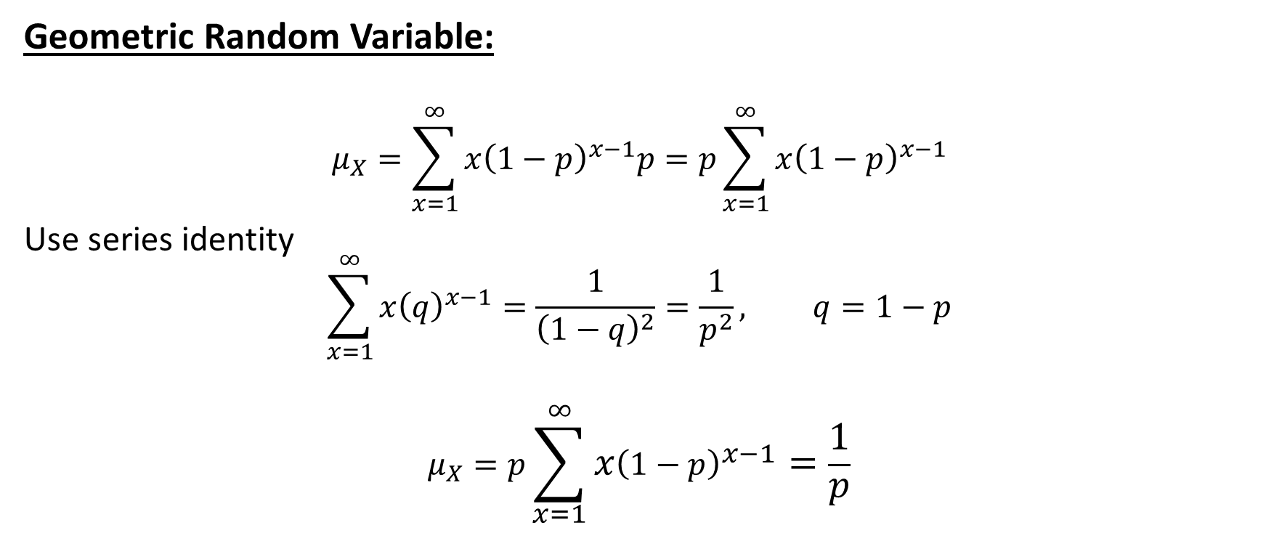
Mean of a Geometric Random Variable
Geometric Random Variable:
$$μ_{X}=\sum_{x=1}^{∞}{x{\left(1−p\right)}^{x−1}p=p\sum_{x=1}^{∞}{x{\left(1−p\right)}^{x−1}}}$$
Use series identity
$$\sum_{x=1}^{∞}{x{\left(q\right)}^{x−1}=\frac{1}{{\left(1−q\right)}^{2}}=\frac{1}{p^{2}}}, q=1−p$$
$$μ_{X}=p\sum_{x=1}^{∞}{x{\left(1−p\right)}^{x−1}=\frac{1}{p}}$$

Slide 22
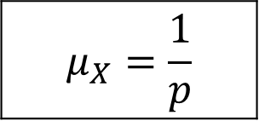
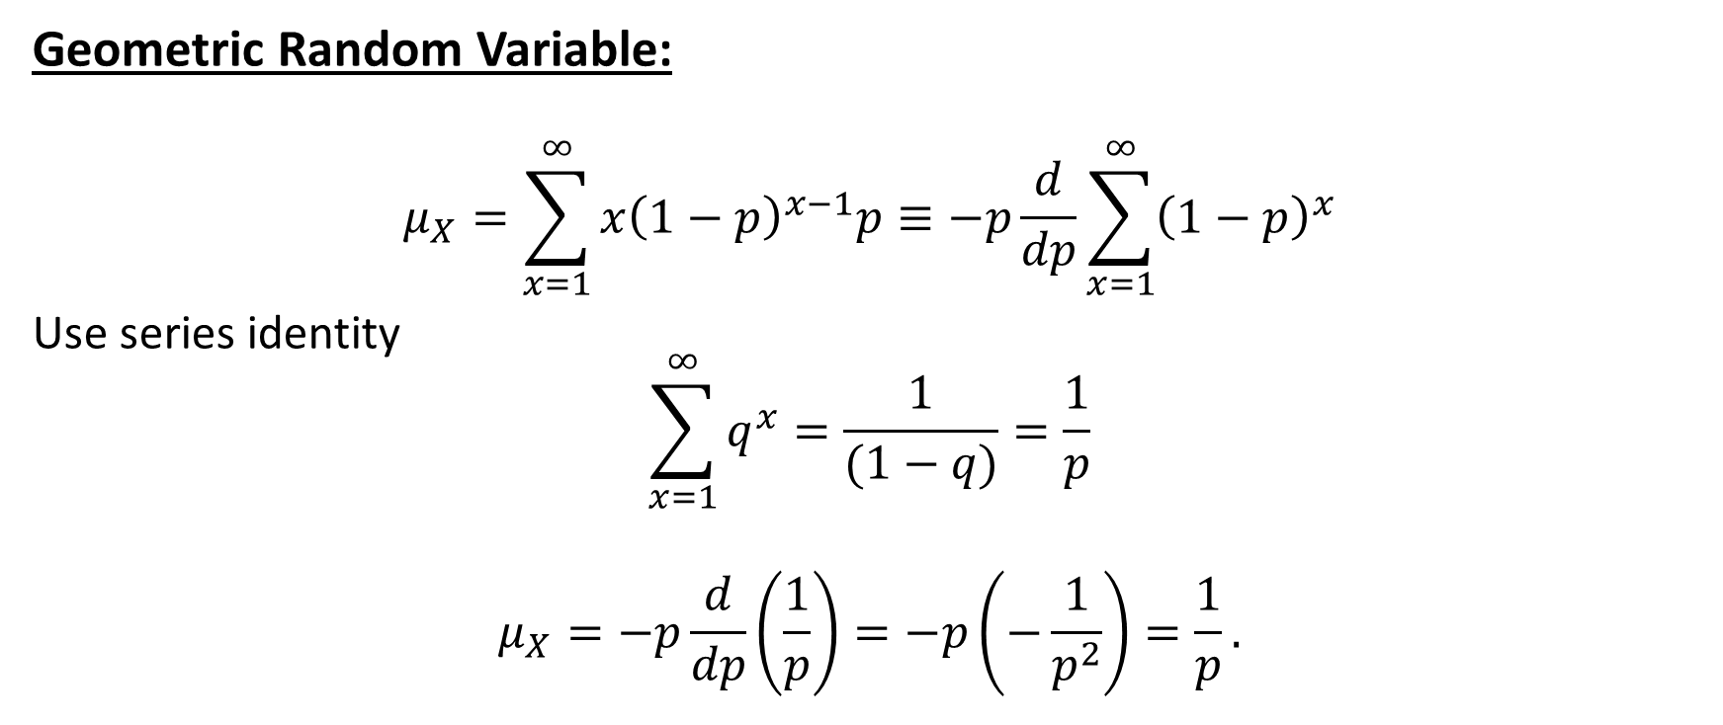
Mean of Special Discrete Random Variables
Geometric Random Variable:
$$μ_{X}=\sum_{x=1}^{∞}{x{\left(1−p\right)}^{x−1}p≡−p\frac{d}{dp}\sum_{x=1}^{∞}{{\left(1−p\right)}^{x}}}$$
Use series identity
$$\sum_{x=1}^{∞}{q^{x}}=\frac{1}{(1−q)}=\frac{1}{p}$$
$$μ_{X}=−p\frac{d}{dp}\left(\frac{1}{p}\right)=−p\left(−\frac{1}{p^{2}}\right)=\frac{1}{p}.$$
$$μ_{X}=\frac{1}{p}$$

Slide 23
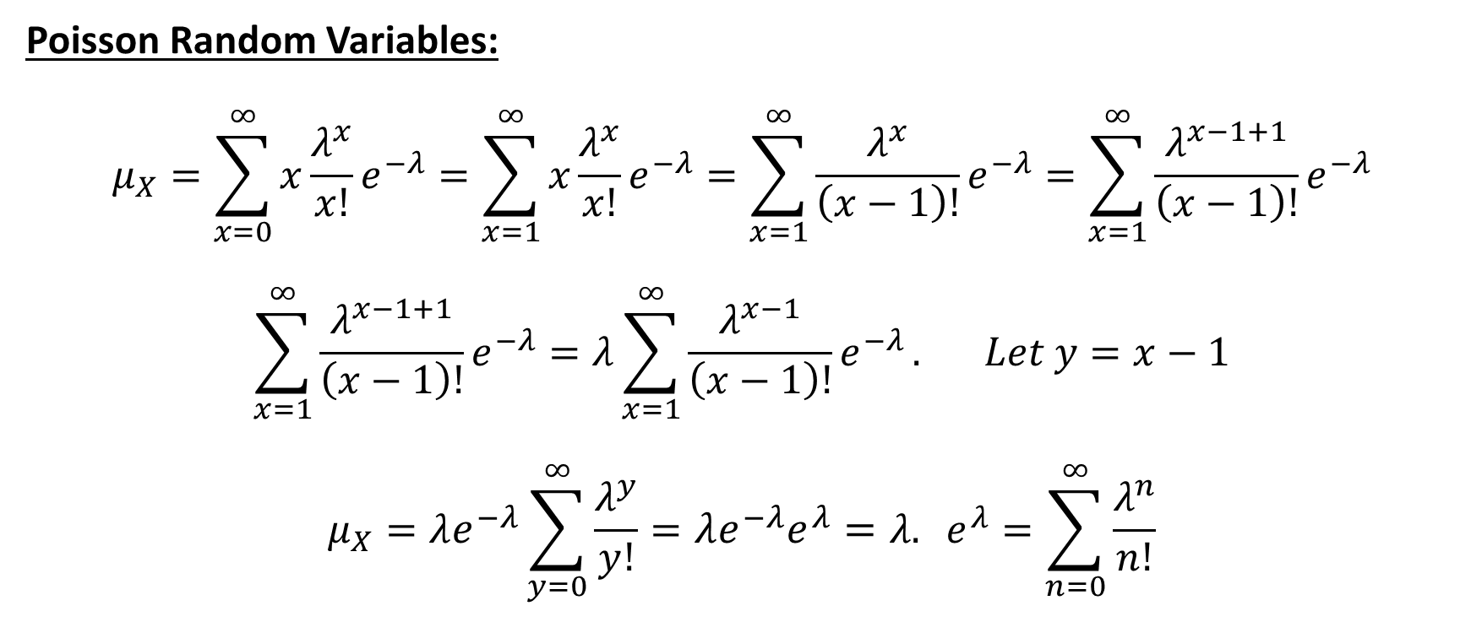
Mean of Special Discrete Random Variables
Poisson Random Variables:
$$μ_{X}=\sum_{x=0}^{∞}{x\frac{λ^{x}}{x!}e^{−λ}=\sum_{x=1}^{∞}{x\frac{λ^{x}}{x!}e^{−λ}}=\sum_{x=1}^{∞}{\frac{λ^{x}}{\left(x−1\right)!}e^{−λ}}=\sum_{x=1}^{∞}{\frac{λ^{x−1+1}}{\left(x−1\right)!}e^{−λ}}}$$
$$\sum_{x=1}^{∞}{\frac{λ^{x−1+1}}{\left(x−1\right)!}e^{−λ}}=λ\sum_{x=1}^{∞}{\frac{λ^{x−1}}{\left(x−1\right)!}e^{−λ}}. Let y=x−1$$
$$μ_{X}=λe^{−λ}\sum_{y=0}^{∞}{\frac{λ^{y}}{y!}}={λe^{−λ}e}^{λ}=λ. e^{λ}=\sum_{n=0}^{∞}{\frac{λ^{n}}{n!}}$$

Slide 24

Mean of a Discrete Uniform Random Variable
Uniform Random Variable: Use formula,
$$\sum_{i=1}^{n}{i}=\frac{n\left(n+1\right)}{2}$$
$$μ_{X}=\sum_{x=k}^{l}{\frac{x}{l−k+1}. Let y=x−k+1⇒x=y+k−1}$$
$$μ_{X}=\sum_{y=1}^{l−k+1}{\frac{y+k−1}{l−k+1}}=\sum_{y=1}^{l−k+1}{\frac{y}{l−k+1}}+\sum_{y=1}^{l−k+1}{\frac{k−1}{l−k+1}}$$
$$μ_{X}=\frac{1}{n}\sum_{y=1}^{n}{y}+\frac{1}{n}\sum_{y=1}^{n}{\left(k−1\right),} where n=l−k+1$$

Slide 25
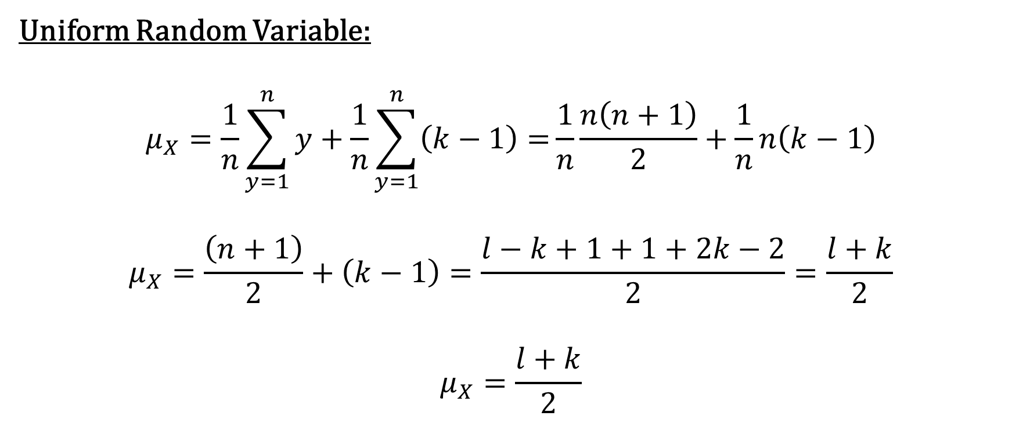
Mean of Special Discrete Random Variables
Uniform Random Variable:
$$μ_{X}=\frac{1}{n}\sum_{y=1}^{n}{y}+\frac{1}{n}\sum_{y=1}^{n}{\left(k−1\right)=}\frac{1}{n}\frac{n\left(n+1\right)}{2}+\frac{1}{n}n\left(k−1\right)$$
$$μ_{X}=\frac{\left(n+1\right)}{2}+\left(k−1\right)=\frac{l−k+1+1+2k−2}{2}=\frac{l+k}{2}$$
$$μ_{X}=\frac{l+k}{2}$$

Slide 26
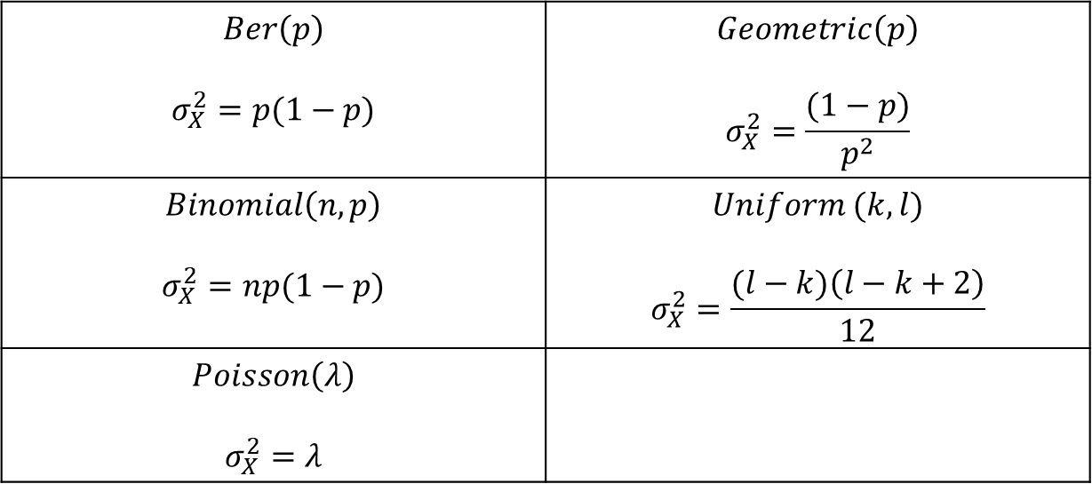
Variances of Special Random Variables
$$Ber\left(p\right)$$ $$σ_{X}^{2}=p(1−p)$$ | $$Geometric\left(p\right)$$ $$σ_{X}^{2}=\frac{(1−p)}{p^{2}}$$
$$Binomial\left(n,p\right)$$ $$σ_{X}^{2}=np(1−p)$$ | $$Uniform (k,l)$$ $$σ_{X}^{2}=\frac{(l−k)\left(l−k+2\right)}{12}$$
$$Poisson\left(λ\right)$$ $$σ_{X}^{2}=λ$$

Slide 27
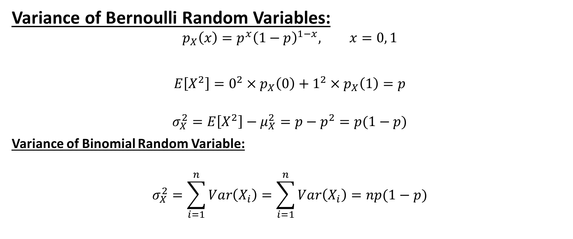
Variances of Special Random Variables
Variance of Bernoulli Random Variables:
$$p_{X}\left(x\right)=p^{x}{\left(1−p\right)}^{1−x}, x=0, 1$$
$$E\left[X^{2}\right]=0^{2}×p_{X}\left(0\right)+1^{2}×p_{X}\left(1\right)=p$$
$$σ_{X}^{2}=E\left[X^{2}\right]−μ_{X}^{2}=p−p^{2}=p(1−p)$$
Variance of Binomial Random Variable:
$$σ_{X}^{2}=\sum_{i=1}^{n}{Var\left(X_{i}\right)}=\sum_{i=1}^{n}{Var\left(X_{i}\right)=np(1−p)}$$

Slide 28
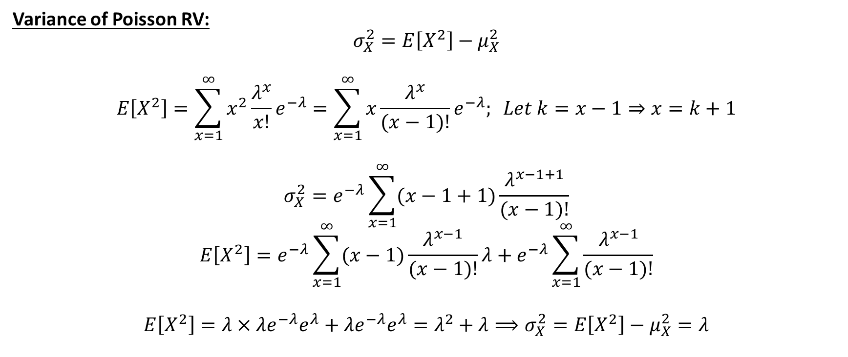
Variances of Special Random Variables
Variance of Poisson RV:
$$σ_{X}^{2}=E\left[X^{2}\right]−μ_{X}^{2}$$
$$E\left[X^{2}\right]=\sum_{x=1}^{∞}{x^{2}\frac{λ^{x}}{x!}e^{−λ}=\sum_{x=1}^{∞}{x\frac{λ^{x}}{(x−1)!}e^{−λ}; Let k=x−1⇒x=k+1}}$$
$$σ_{X}^{2}=e^{−λ}\sum_{x=1}^{∞}{(x−1+1)\frac{λ^{x−1+1}}{(x−1)!}}$$
$$E\left[X^{2}\right]=e^{−λ}\sum_{x=1}^{∞}{(x−1)\frac{λ^{x−1}}{(x−1)!}}λ+e^{−λ}\sum_{x=1}^{∞}{\frac{λ^{x−1}}{(x−1)!}}$$
$$E\left[X^{2}\right]={λ×λe}^{−λ}e^{λ}+{λe}^{−λ}e^{λ}=λ^{2}+λ⟹σ_{X}^{2}=E\left[X^{2}\right]−μ_{X}^{2}=λ$$

Slide 29
Variances of Special Random Variables
Variance of Geometric Random Variables:

Slide 30

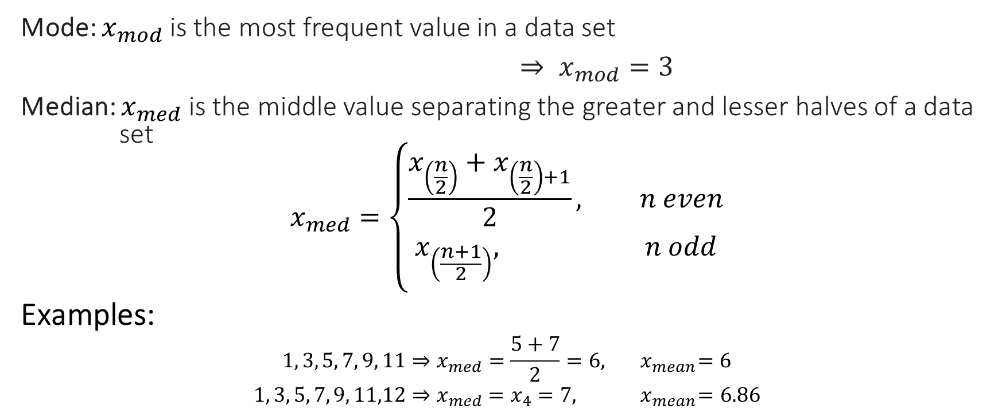
Mode and Median of a Data Set
Mode: $x_{mod}$is the most frequent value in a data set
$⇒ x_{mod}=3$
Median: $x_{med}$is the middle value separating the greater and lesser halves of a data set
$$x_{med}=\left\{\begin{aligned}\frac{x_{\left(\frac{n}{2}\right)}+x_{\left(\frac{n}{2}\right)+1}}{2}, n even \\ &x_{\left(\frac{n+1}{2}\right)}, n odd\end{aligned}\right.$$
Examples:
$$1, 3, 5, 7, 9, 11⇒x_{med}=\frac{5+7}{2}=6, { x}_{mean}=6$$
$$1, 3, 5, 7, 9, 11,12⇒x_{med}=x_{4}=7, { x}_{mean}=6.86$$
$$1, 3, 5, 2, 3, 6, 3, 4, 8$$

Slide 31
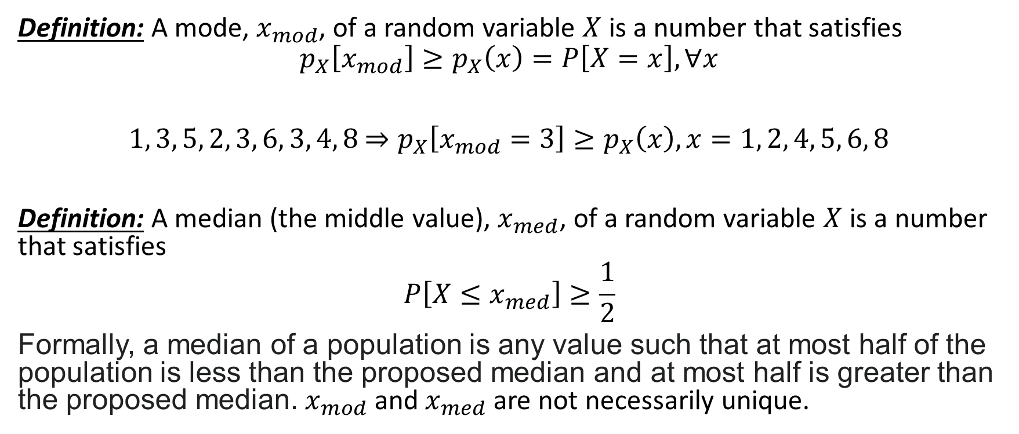
Mode and Median of Random Variables
Definition: A mode, $x_{mod}$, of a random variable $X$ is a number that satisfies
$$p_{X}\left[x_{mod}\right]≥p_{X}\left(x\right)=P\left[X=x\right], ∀x$$
$1, 3, 5, 2, 3, 6, 3, 4, 8$ $⇒p_{X}\left[x_{mod}=3\right]≥p_{X}\left(x\right), x=1, 2, 4, 5, 6, 8$
Definition: A median (the middle value), $x_{med}$, of a random variable $X$ is a number that satisfies
$$P\left[X≤x_{med}\right]≥\frac{1}{2}$$
Formally, a median of a population is any value such that at most half of the population is less than the proposed median and at most half is greater than the proposed median. $x_{mod}$ and $x_{med}$ are not necessarily unique.

Slide 32
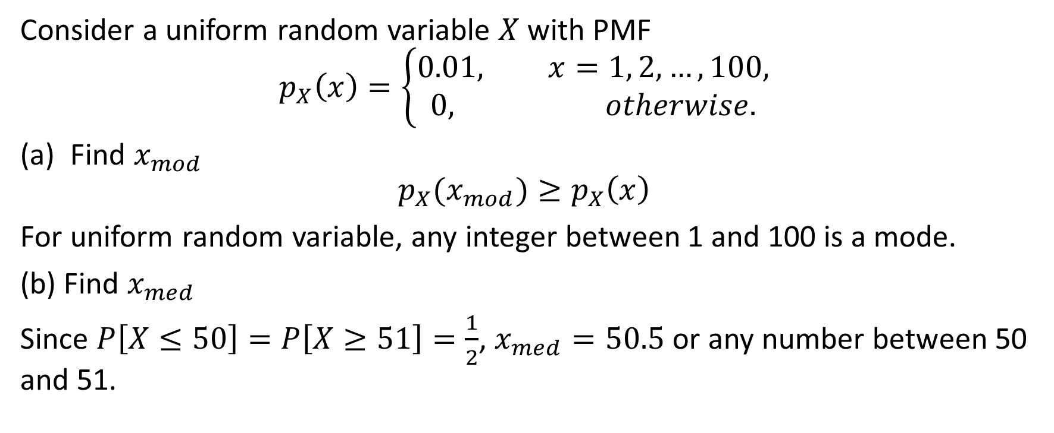
Example on Mode and Median
Consider a uniform random variable $X$ with PMF
$$p_{X}\left(x\right)=\left\{\begin{aligned}0.01, x=1, 2, …, 100, \\ &0, otherwise.\end{aligned}\right.$$
Find $x_{mod}$
$$p_{X}(x_{mod})≥p_{X}\left(x\right)$$
For uniform random variable, any integer between 1 and 100 is a mode.
(b) Find $x_{med}$
Since $P\left[X≤50\right]=P\left[X≥51\right]=\frac{1}{2}$, $x_{med}=50.5$ or any number between 50 and 51.

